Slide 1

Management Information Systems: Managing the Digital Firm
Seventeenth Edition, Global Edition
Chapter 2
Global E-Business and Collaboration
Copyright © 2022, 2020, 2018 Pearson Education, Ltd. All Rights Reserved
Notes:
If this PowerPoint presentation contains mathematical equations, you may need to check that your computer has the following installed:
1) MathType Plugin
2) Math Player (free versions available)
3) NVDA Reader (free versions available)

Slide 2
Learning Objectives
2.1 What are business processes? How are they related to information systems?
2.2 How do systems serve the different management groups in a business, and how do systems that link the enterprise improve organizational performance?
2.3 Why are systems for collaboration and social business so important, and what technologies do they use?
2.4 What is the role of the information systems function in a business?
2.5 How will MIS help my career?
Notes:
This chapter builds on and extends some of the concepts, such as business processes and the different levels of management in a business, that were introduced in Chapter 1. It also provides students with a quick overview of the types of systems found in typical corporations, such as TPS, business intelligence systems, enterprise applications, and systems for collaboration and social business, among others.

Slide 3
Video Cases
Case 1: IS in Action: VisionX Lighting Grows with Business One
Case 2: Cemex: Becoming a Social Business

Slide 4
Enterprise Social Networking Transforms Sharp Corporation into a More Innovative Connected Organization (1 of 2)
Problem
  Hierarchical top-down processes
  New competitors
  Lack of collaboration and idea sharing
Solutions
  Develop knowledge-sharing strategy and goals
  Redesign knowledge-sharing and collaboration processes
  Change organizational culture
  Implement Microsoft Yammer collaboration software
Notes:
Ask students if they have ever worked in an organization which they felt was very “top down,” hierarchical, and not very collaborative. Could they see that a system such as Sharp implemented would have helped? What benefits did Sharp receive from their investment in collaboration?

Slide 5
Enterprise Social Networking Transforms Sharp Corporation into a More Innovative Connected Organization (2 of 2)
Use of new information systems to improve performance and remain competitive
Demonstrates importance of teamwork and collaboration for innovation and profit growth
Illustrates importance of organizational culture and business processes for knowledge dissemination

Slide 6
Business Processes (1 of 2)
Business processes
  Flows of material, information, knowledge
  Logically related set of tasks that define how specific business tasks are performed
  May be tied to functional area or be cross-functional
Businesses: Can be seen as collection of business processes
Business processes may be assets or liabilities
Notes:
Business processes are at the heart of every business. Ask students if they can give any examples of business processes that they regularly come in contact with. This could include anything from ordering food at McDonalds to applying for a driver's license at the DMV. Emphasize that studying a firm's business processes is an excellent way to learn a great deal about how that business actually works. How could a business process be a liability? Ask students to describe a dysfunctional business process that they may have encountered.

Slide 7
Business Processes (2 of 2)
Examples of functional business processes
  Manufacturing and production
    Assembling the product
  Sales and marketing
    Identifying customers
  Finance and accounting
    Creating financial statements
  Human resources
    Hiring employees
Notes:
Other examples include checking the product for quality (manufacturing and production), selling the product (sales and marketing), paying creditors (finance and accounting), and evaluating job performance (human resources). You could ask students to contribute other examples of business processes and describe which of the four types they are.

Slide 8
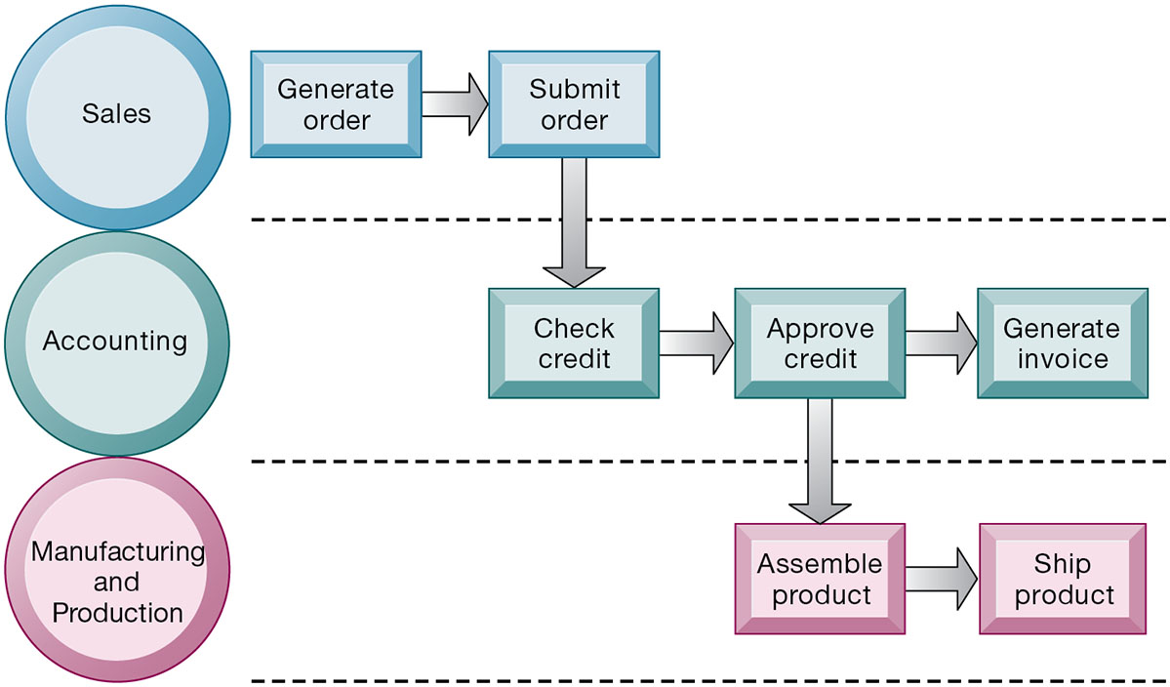
Figure 2.1 The Order Fulfillment Process
Notes:
Figure 2.1, Page 43.
Fulfilling a customer order involves a complex set of steps that requires the close coordination of the sales, accounting, and manufacturing functions.
Emphasize that each rectangle represents one part of the larger business process of order fulfillment. Notice that this business process spans several different functional areas of the business from sales (orders), to accounting, to manufacturing. Important business processes typically span several different functional areas or divisions in a business.
Alt Text
Long description: An illustration explains the process followed to fulfil customer orders. There are three levels in the illustration and the flow is distributed among these levels. The levels are: Sales, accounting, and manufacturing and production. The sequence of the flow is as follows:
Generate order followed by submit order in level 1.
Check credit, approve credit, and generate invoice in level 2.
Assemble product immediately after approving credit followed by ship product in level 3.

Slide 9
How Information Technology Improves Business Processes
Increasing efficiency of existing processes
  Automating steps that were manual
Enabling entirely new processes
  Changing flow of information
  Replacing sequential steps with parallel steps
  Eliminating delays in decision making
  Supporting new business models
Notes:
Examples of entirely new business processes made possible by information technology are downloading a song from iTunes or buying a book or e-book from Amazon. You might also mention the Amazon Kindle e-book which is continuously connected to the Internet and allows customers to download books and pay for them using Amazon’s one-click purchase method. Ask students if they can name any other business processes that have been transformed in the last few years.

Slide 10
Systems for Different Management Groups (1 of 2)
Transaction processing systems
  Serve operational managers and staff
  Perform and record daily routine transactions necessary to conduct business
    Examples: sales order entry, payroll, shipping
  Allow managers to monitor status of operations and relations with external environment
  Serve predefined, structured goals and decision making
Notes:
The purpose of these systems is to answer routine questions about the flow of transactions through the organization. These systems are a necessity for any business.

Slide 11
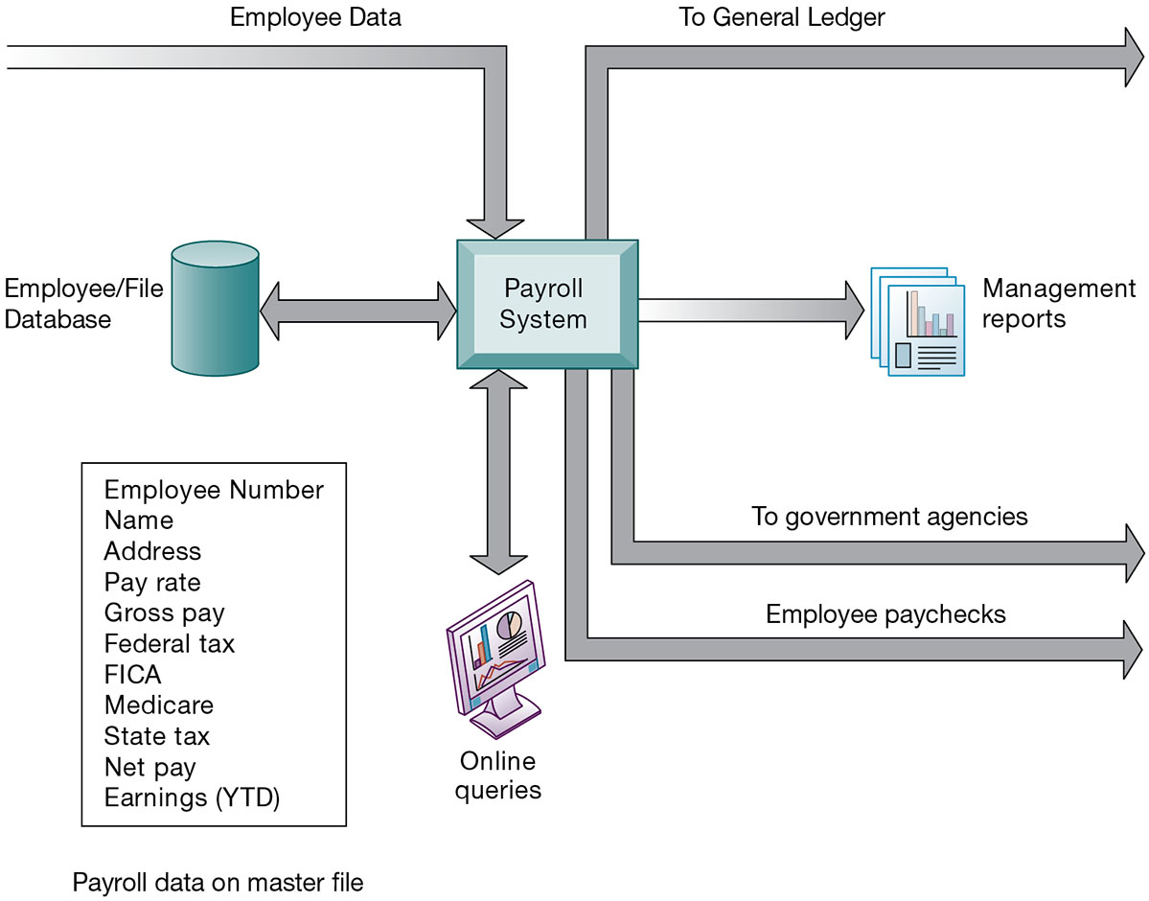
Figure 2.2 A Payroll T P S
Notes:
Figure 2.2, Page 47.
A TPS for payroll processing captures employee payment transaction data (such as a time card). System outputs include online and hard-copy reports for management and employee paychecks.
Note that the outputs of the payroll system are useful not only within the company to managers, but also to regulatory agencies and other entities relying on the accuracy of the reported data.
Alt Text
Long description: A figure illustrates a typical payroll TPS found in many firms. The details are as follows: Employee data is fed into the payroll system. The payroll system generates reports and are sent to management and government agencies. It also generates employee paychecks and goes into the general ledger. A two-way connection between the payroll system and online queries and employee or file data base is also illustrated in this figure. The employee or file data base consists of the following elements: Employee Number, Name, Address, Pay rate, Gross pay, Federal tax, FICA, Medicare, State tax, Net pay, and Earnings (YTD). These elements constitute the payroll data on master file.

Slide 12
Systems for Different Management Groups (2 of 2)
Systems for business intelligence
  Data and software tools for organizing and analyzing data
  Used to help managers and users make improved decisions
Management information systems
Decision support systems
Executive support systems
Notes:
This slide emphasizes the relationship between the class of software called “business intelligence” and the decision support systems used by middle and senior management: MIS, DSS and ESS. Business intelligence is a type of software used in analyzing data.

Slide 13
Management Information Systems
Serve middle management
Provide reports on firm’s current performance, based on data from T P S
Provide answers to routine questions with predefined procedure for answering them
Typically have little analytic capability
Notes:
Emphasize to students that management information systems is a specific category of information systems for middle management. It has the same name, but a very different meaning from the term introduced in Chapter 1 (the study of information systems in business and management). In other words, the study of management information systems involves looking at all the systems used in business. An MIS system is a specific type of an information system. It’s easy to get the two confused.

Slide 14
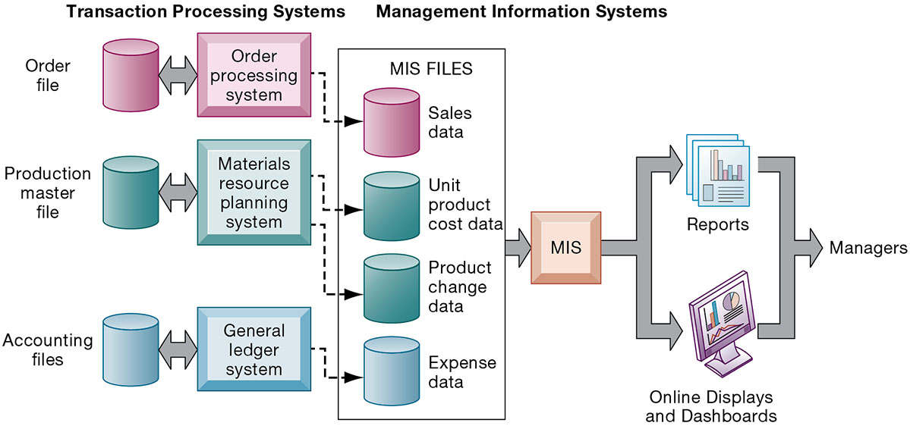
Figure 2.3 How Management Information Systems Obtain Their Data from the Organization’s T P S
Notes:
Figure 2.3, Page 46.
In the system illustrated by this diagram, three TPS supply summarized transaction data to the MIS reporting system at the end of the time period. Managers gain access to the organizational data through the MIS, which provides them with the appropriate reports.
Emphasize the relationship between TPS and MIS here. MIS receive data from an organization’s TPS systems and create outputs that management can use to make decisions.
Alt Text
Long description: A figure illustrates how the MIS transforms transaction level data from inventory, production, and accounting into MIS files and provide reports. The details of the figure are as follows: Under the transaction processing system are: Order, production master, and accounting files. A two-way connection is depicted between these files and order processing system, material resource planning system, and general ledger system. Under the management information systems, the following files are present: Sales data, unit product cost data, product change data, and expense data. All these files are connected to the MIS which generates reports, online displays and dashboards. These are later sent to the managers. The MIS files under the management information systems are connected to the various transaction processing systems as follows:
Order processing system: Sales data.
Material resource planning system: Unit product cost data and product change data.
General ledger system: Expense data.

Slide 15
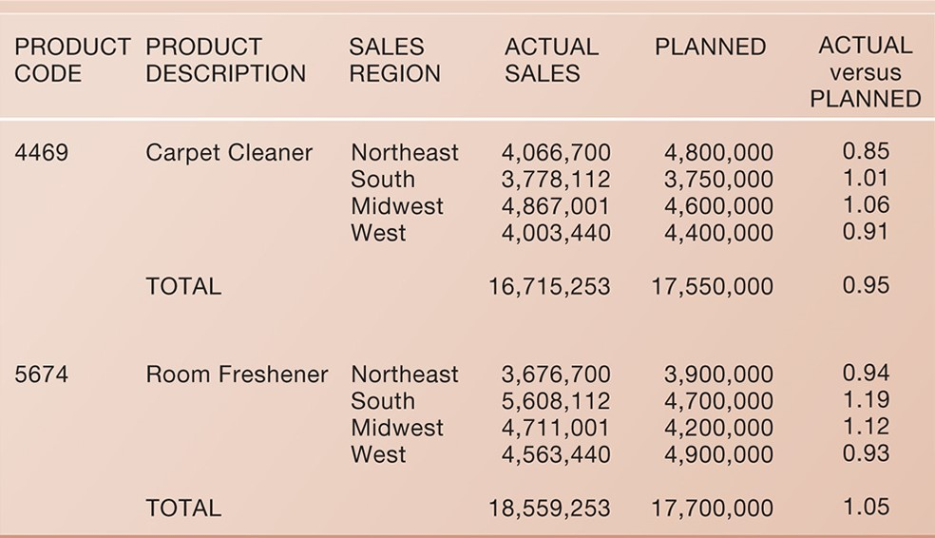
Figure 2.4 Sample M I S Report
Consolidated Consumer Products Corporation Sales by Product and Sales Region: 2020
Notes:
Figure 2.4, Page 47.
This report, showing summarized annual sales data, was produced by the MIS in Figure 2.3.
This graphic represents the “reports” portion of Figure 2-3. Emphasize this to students, perhaps referencing that slide again to drive home that point. Students may not understand the decimals in the “ACTUAL versus PLANNED” category, where anything above 1.00 represents more sales than planned and anything less represents a disappointing result of fewer sales than planned.
Alt Text
Long description: A sample report showing summarized annual sales data generated by the MIS. The details of the report are as below:
Consolidated Consumer Products Corporation Sales by Product and Sales Region: 2020.
The report generated summarizes the details pertaining to the product code, product description, sales region, actual sales, planned sales, and actual versus planned percentage.
4469: Carpet cleaner; Northeast; 4,066,700; 4,800,000; 0.85.
4469: Carpet cleaner; South; 3,778,112; 3,750,000; 1.01.
4469: Carpet cleaner; Midwest; 4,867,001; 4,600,000; 1.06.
4469: Carpet cleaner; West; 4,003,440; 4,400,000; 0.91.
Total: Actual sales, 16,715,253; Planned sales, 17,550,000; Actual versus planned percentage, 0.95.
5674: Room freshener; Northeast; 3,676,700; 3,900,000; 0.94.
5674: Room freshener; South; 5,608,112; 4,700,000; 1.19.
5674: Room freshener; Midwest; 4,711,001; 4,200,000; 1.12.
5674: Room freshener; West; 4,563,440; 4,900,000; 0.93.
Total: Actual sales, 18,559,253; Planned sales, 17,700,000; Actual versus planned percentage, 1.05

Slide 16
Decision Support Systems
Serve middle management
Support nonroutine decision making
  Example: What is the impact on production schedule if December sales doubled?
May use external information as well as T P S / M I S data
Model driven D S S
  Voyage-estimating systems
Data driven D S S
  Intrawest’s marketing analysis systems
Notes:
You could ask whether or not students understand what is meant by nonroutine decision making, as opposed to routine decision making, and why DSS are specifically designed to assist managers in making that type of decision. Ask students for examples of nonroutine decisions they make or have made in the past as managers or employees.

Slide 17
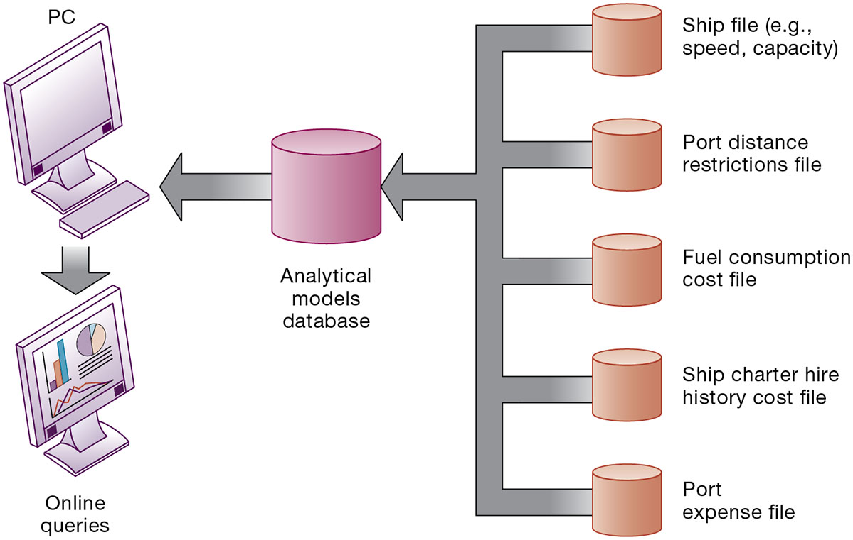
Figure 2.5 Voyage-Estimating Decision-Support System
Notes:
Figure 2.5, Page 48.
This DSS operates on a powerful PC. It is used daily by managers who must develop bids on shipping contracts.
DSS can rely on either analytical models or large databases to provide valuable information. You could ask which of these two types the above figure best resembles (analytical models). You could also ask them what types of decisions does this system help its users make? Examples include what vessels to send to particular destinations to maximize profit, the optimal loading pattern for cargo, and the optimal rate at which vessels should travel to maximize efficiency while still meeting their schedules, and so forth.
Alt Text
Long description: A figure illustrates how this voyage-estimating DSS operates on a powerful personal computer and enables users to enter data or obtain information. The details of the DSS are as below:
The different types of files listed below are connected to the analytical models database in this illustration. The database in turn is connected to a personal computer through which online queries are generated.
Ship file; Example: Speed and capacity.
Port distance restrictions file.
Fuel consumption cost file.
Ship charter hire history cost file.
Port expense file.

Slide 18
Executive Support Systems
Support senior management
Address nonroutine decisions
  Requiring judgment, evaluation, and insight
Incorporate data about external events (e.g., new tax laws or competitors) as well as summarized information from internal M I S and D S S
Example: Digital dashboard with real-time view of firm’s financial performance
Notes:
Emphasize the connection between ESS, MIS, and DSS. ESS rely on accurate inputs from a firm’s MIS and DSS to provide useful information to executives. These systems should not exist in isolation from one another. If they are isolated from one another, it is a kind of organizational dysfunction, probably inherited from the past. Note that the digital dashboard is a common feature of modern-day ESS. Emphasize that a critical feature of ESS is ease of use and simplicity of display. Executives using an ESS want quick access to the most critical data affecting their firm.

Slide 19
Enterprise Applications
Systems for linking the enterprise
Span functional areas
Execute business processes across the firm
Include all levels of management
Four major applications
  Enterprise systems
  Supply chain management systems
  Customer relationship management systems
  Knowledge management systems
Notes:
Enterprise applications are used to coordinate and integrate the information used in the systems discussed previously. In other words, enterprise applications are used to ensure that TPS, MIS, DSS, and ESS work together smoothly.

Slide 20
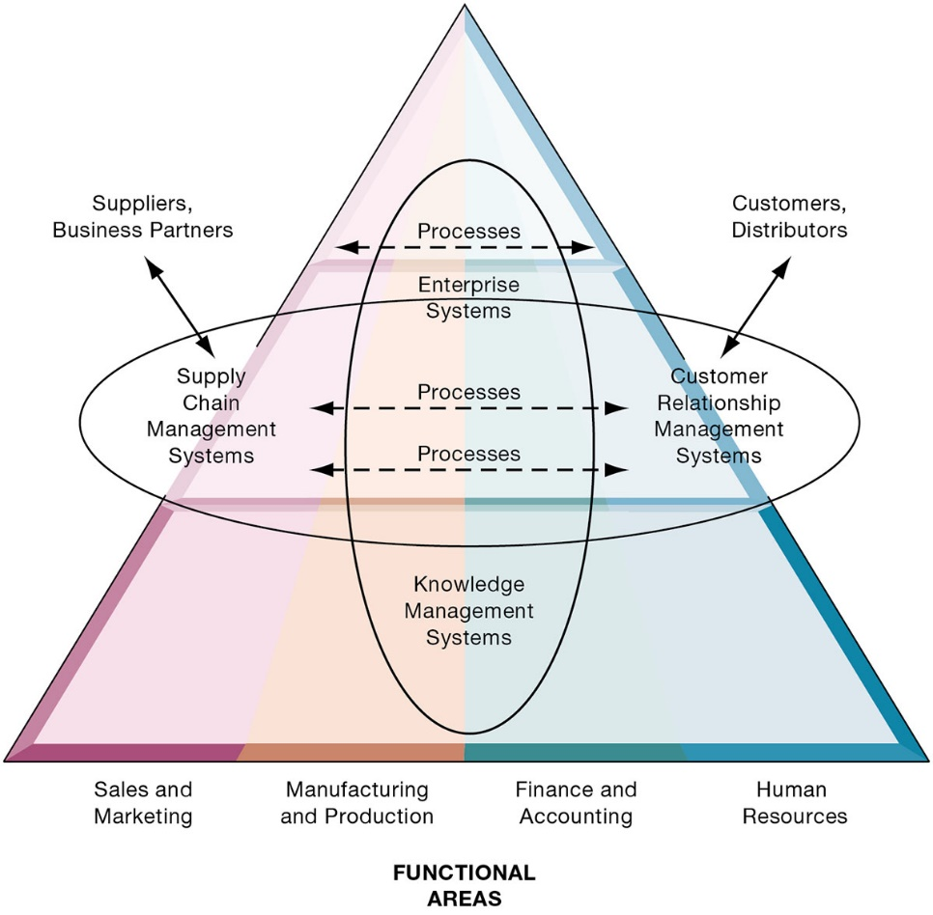
Figure 2.6 Enterprise Application Architecture
Notes:
Figure 2.6, Page 50.
Enterprise applications automate processes that span multiple business functions and organizational levels and may extend outside the organization.
This graphic illustrates that enterprise systems are databases that pull information from many parts of the firm and enable processes across the firm at different organizational levels, as well as with suppliers and customers. The triangle represents the organization, with different colors for the four main business functions. The ovals show that an enterprise application architecture incorporates systems used in sales and marketing, enabling these to communicate with each other and with suppliers and customers. It also incorporates information supplied by KMS and other enterprise systems. The purpose of incorporating data from all of these sources is to enable and automate cross-functional business processes and supply accurate information to aid decision making.
Alt Text
Long description: A pyramid diagram shows the classification scheme of architectures and their important functional areas. There are four primary functional areas of the enterprise architecture: Sales and marketing, manufacturing and production, finance and accounting, and human resources. The functional areas are depicted at the bottom of the pyramid. These areas are depicted as shaded regions in the pyramid and converging at the top.
Under sales and marketing is the supply chain management systems. This is interconnected, via a two-way arrow, and suppliers and business partners that lie on the left outside the pyramid.
Under manufacturing and production and finance and accounting areas are the knowledge management systems, processes, and enterprise systems. All these are enclosed in an ellipse in the diagram.
Under the human resources is the customer relationship management systems. This is interconnected, via a two-way arrow, to the customers and distributers that lie to the right outside the pyramid.
The supply chain management systems and customer relationship management systems are interconnected through processes at various levels. This schematic is also enclosed in an ellipse in the diagram.

Slide 21
Enterprise Systems
Also called enterprise resource planning (E R P) systems
Integrate data from key business processes into single system
Speed communication of information throughout firm
Enable greater flexibility in responding to customer requests, greater accuracy in order fulfillment
Enable managers to assemble overall view of operations
Notes:
This slide emphasizes the singularity of enterprise systems (one system) that integrates information flows from a variety of sources and serves a wide variety of groups and purposes in the firm. Remind students of the difference between enterprise applications and enterprise systems: Enterprise applications are any applications that span the enterprise, and types of enterprise applications include CRM, SCM, KMS, and enterprise systems. The business processes supported by enterprise systems are primarily internal. Note that enterprise systems are sometimes also referred to as enterprise resource planning systems (ERP).

Slide 22
Supply Chain Management (S C M) Systems
Manage relationships with suppliers, purchasing firms, distributors, and logistics companies
Manage shared information about orders, production, inventory levels, and so on
Goal is to move correct amount of product from source to point of consumption as quickly as possible and at lowest cost
Type of interorganizational system: Automating flow of information across organizational boundaries
Notes:
Emphasize that SCM systems are interorganizational systems, automating the flow of information across organizational boundaries. This distinction is important because SCM systems must be designed with the business processes of potential partners and suppliers in mind.

Slide 23
Customer Relationship Management (C R M) Systems
Help manage relationship with customers
Coordinate business processes that deal with customers in sales, marketing, and customer service
Goals:
  Optimize revenue
  Improve customer satisfaction
  Increase customer retention
  Identify and retain most profitable customers
  Increase sales
Notes:
CRM systems are extremely important for both marketing and customer service. You could ask students if they’ve ever filled out a survey for a company. Then connect that to information systems, perhaps explaining that the information they entered was provided as input to a CRM system for analysis.

Slide 24
Knowledge Management Systems (K M S)
Manage processes for capturing and applying knowledge and expertise
Collect relevant knowledge and make it available wherever needed in the enterprise to improve business processes and management decisions
Link firm to external sources of knowledge
Notes:
The idea that business firms are repositories of knowledge may be new to many students. Ask students for examples of firm knowledge, for instance, the knowledge required to run a fast-food restaurant, or the knowledge required to operate a website such as Amazon. Explain that knowledge management systems are useful for helping a firm's employees understand how to perform certain business processes or how to solve problems. What might the consequences be for a firm with poor knowledge management systems?

Slide 25
Intranets and Extranets
Technology platforms that increase integration and expedite the flow of information
Intranets:
  Internal networks based on Internet standards
  Often are private access area in company’s website
Extranets:
  Company websites accessible only to authorized vendors and suppliers
  Facilitate collaboration
Notes:
Intranets and extranets use Internet technology to communicate internally to employees, allow employees to communicate with one another and share documents, and to help communication with vendors. They are essentially password-protected websites. The simplest intranets and extranets may use static web pages to relay information, whereas more sophisticated versions may be database-driven and enable key business processes.
Ask students if they have used an intranet or extranet before and what services or information it provided. Does their school have an intranet/extranet? Generally universities have a website with different levels of access for the general public, registered students, faculty, and administrators. The public-facing part of the website can be thought of as the “extranet,” whereas the part of the website serving students and faculty can be thought of as the “intranet.” These terms (intranet and extranet) are fading from use, but students will occasionally find firms still using them.

Slide 26
E-business, E-commerce, and
E-government
E-business
  Use of digital technology and Internet to drive major business processes
E-commerce
  Subset of e-business
  Buying and selling goods and services through Internet
E-government
  Using Internet technology to deliver information and services to citizens, employees, and businesses
Notes:
The use of Internet technology has transformed and continues to transform businesses and business activity. This slide aims to distinguish different terminology used in the book.
E-business refers to the use of the Internet and networking to enable all parts of the business, whereas e-commerce refers to just that part of the business that involves selling goods and services over the Internet.
Internet technology has also brought similar changes in the public sector—the use of Internet and networking technologies in government is referred to as e-government. Ask students what changes in businesses or government due to new Internet technologies they have noticed.

Slide 27
Interactive Session: Organizations: The City of Mississauga Goes Digital
Class discussion
  Describe the problems the City of Mississauga hoped to address using digital technology.
  What technologies did Mississauga employ for a solution? Describe each of these technologies and the role each played in a solution.
  What management, organization, and technology issues did the City of Mississauga have to address in developing a solution?.
  How did the technologies in this case improve operations and decision making at the City of Mississauga?
Notes:
Ask students if the governments in the places where they have lived have implemented digital technology in a manner similar to the City of Mississauga.

Slide 28
What is Collaboration?
Collaboration
  Short lived or long term
  Informal or formal (teams)
Growing importance of collaboration
  Changing nature of work
  Growth of professional work—“interaction jobs”
  Changing organization of the firm
  Changing scope of the firm
  Emphasis on innovation
  Changing culture of work
Notes:
A number of factors are leading to a growing emphasis on collaboration in the firm. Work is changing, requiring more cooperation and coordination. Professions play a larger role in firms than before, and this often requires more consultation among experts. Organizations are flatter, with many more decisions made far down in the hierarchy. Organizations are more far flung around the globe, in multiple locations. There’s an emphasis on finding and sharing ideas, which requires collaboration. Finally, what it means to be a “good” employee these days is in part an ability to work with others and collaborate effectively. The culture of work has changed.

Slide 29
What is Social Business?
Social business
  Use of social networking platforms (internal and external) to engage employees, customers, and suppliers
Aims to deepen interactions and expedite information sharing
“Conversations” to strengthen bonds with customers
Requires information transparency
Seen as way to drive operational efficiency, spur innovation, accelerate decision making
Notes:
Ask students how they use social sites such as Facebook, and if they have ever used these sites for business purposes. How about Twitter, Pinterest, or Instagram?

Slide 30
Business Benefits of Collaboration and Teamwork
Investment in collaboration technology can return large rewards, especially in sales and marketing, research and development
Productivity: Sharing knowledge and resolving problems
Quality: Faster resolution of quality issues
Innovation: More ideas for products and services
Customer service: Complaints handled more rapidly
Financial performance: Generated by improvements in factors above
Notes:
Research regarding the business benefits of collaboration is anecdotal; however, business and academic communities generally regard collaboration as an essential driving factor in business success: Firms that collaborate more make more money.
Ask students to give examples of how collaboration can improve productivity, product quality, and customer service. Has anyone had a fruitful collaborative experience in which an aspect of a company they worked at or an organization they were in?

Slide 31
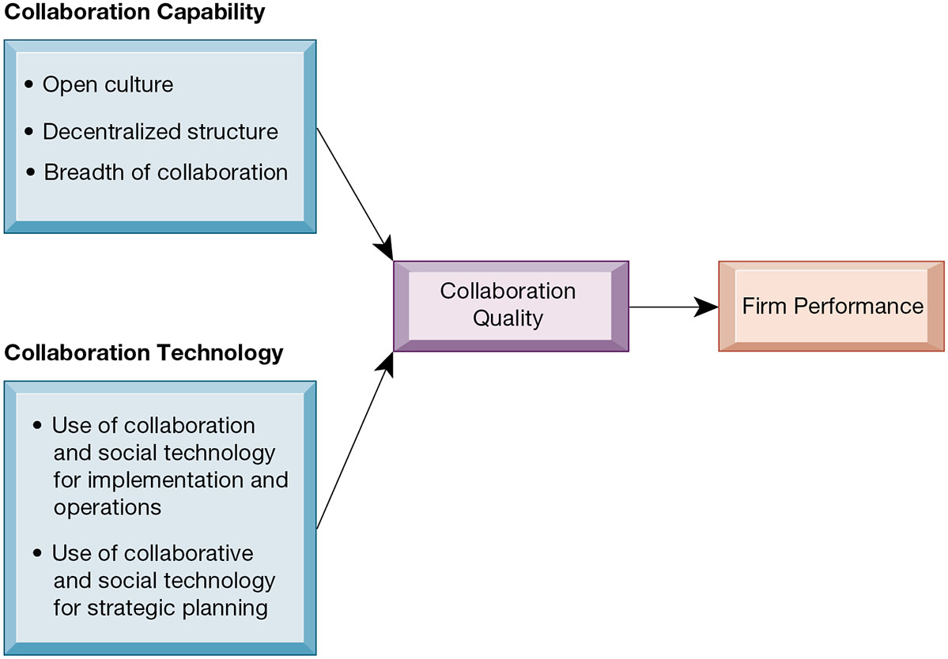
Figure 2.7 Requirements for Collaboration
Notes:
Figure 2.7, Page 58.
Successful collaboration requires an appropriate organizational structure and culture along with appropriate collaboration technology.
This slide graphically describes how collaboration is believed to impact business performance. Two primary ingredients are needed: collaboration capability (including how much collaboration is possible) and collaboration technology or means. The quality of these two factors directly affects firm performance—the higher quality of collaboration means better firm performance. Ask students how collaboration can be high or low quality? An example of low-quality collaboration could be a team put together to solve a business problem, but which is unable to effectively work together because of internal politics. Do students have any experience with poor collaboration?
Alt Text
Long description: A flow diagram explains how collaboration capability and technology affect the firm’s performance. In this diagram, collaboration capability and technology are connected to the collaboration quality and in turn the firm’s performance.
Collaboration capability includes: Open culture, decentralized structure, and breadth of collaboration.
Collaboration technology includes: Use of collaboration and social technology for implementation and operations; Use of collaborative and social technology for strategic planning.

Slide 32
Building a Collaborative Culture and Business Processes
“Command and control” organizations
  No value placed on teamwork or lower-level participation in decisions
Collaborative business culture
  Senior managers rely on teams of employees
  Policies, products, designs, processes, and systems rely on teams
  The managers purpose is to build teams
Notes:
Collaboration is not something that spontaneously arises—it must be enabled and nurtured. Collaborative culture is an essential factor—simply having collaborative technology will not result in collaboration if it isn’t seen as part of the business and rewarded. Have any students worked at “command and control” organizations? If so, were they able to see aspects of the business that could be improved but were unable to make contributions because of the firm's culture? Are there any businesses or business functions that benefit by less collaboration? Are there any disadvantages to collaboration?

Slide 33
Tools and Technologies for Collaboration and Social Business
E-mail and instant messaging (I M)
Wikis
Virtual worlds
Collaboration and social business platforms
  Virtual meeting systems: videoconferencing, telepresence)
  Cloud collaboration services (Google Drive, Google Docs, etc.)
  Microsoft SharePoint and I B M Notes
  Enterprise social networking tools
Notes:
The text goes into more depth on each of these tools. Give an example for each type of tool. Business uses of social networking and collaboration include Facebook accounts for businesses; using wikis as extended, more complete FAQs; and virtual worlds to conduct online meetings for employees around the world. Distinguish these individual tools from Internet-based collaboration environments, which are suites of collected collaboration tools, enabling communication and data-sharing between tools. How many of your students used Google Docs or a similar cloud collaboration service?

Slide 34
Interactive Session: Technology: : Virtual Education at Ahlia University
Class discussion
  How does Microsoft Teams promote efficient collaboration in universities and colleges?
  What management, organization, and technology based issues did Ahlia University address before pivoting its operations to deal with the pandemic?
  What advantages has using collaboration tools provided for Ahlia University?
Notes:
In the wake of the Covid-19 pandemic, students are likely to have extensive experience using videoconferencing tools such as Zoom, Skype, and others, for online learning, for remote work, and also for social interaction. Ask them to discuss their experiences.

Slide 35
Checklist for Managers: Evaluating and Selecting Collaboration and Social Software Tools
Time/space matrix
Six steps in evaluating software tools
  Identify your firm’s collaboration challenges
  Identify what kinds of solutions are available
  Analyze available products’ cost and benefits
  Evaluate security risks
  Consult users for implementation and training issues
  Evaluate product vendors
Notes:
When evaluating collaboration tools for your businesses, the first step is to identify the kind of problem you have. The key problems are time and location (space). Generally, no one has enough time and often key people are not in the right place. Some teams may need to work together in real-time, whereas others may simply need shared documentation. In analyzing collaboration tools by the space/time dimensions you can determine what types of tools will solve your problem. The six steps in evaluating software are applicable not only for collaboration tools but any software solution for your company. First determine the challenge or problem, look for solutions for this particular problem, and so forth.

Slide 36
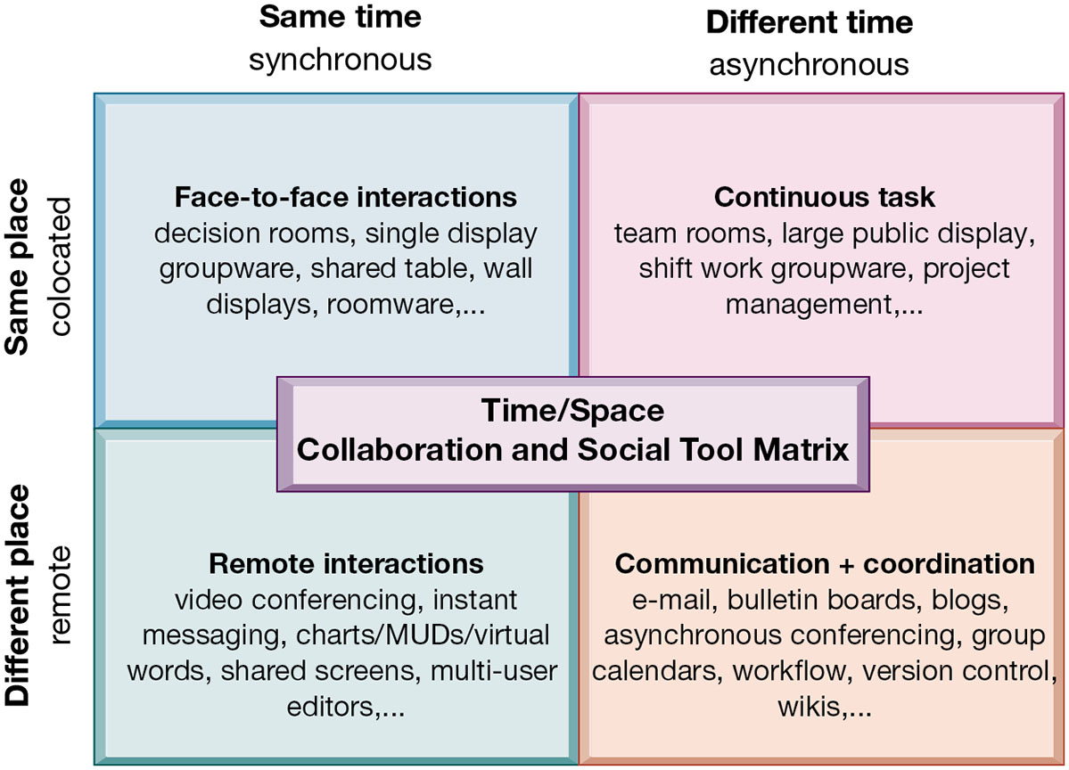
Figure 2.8 The Time/Space Collaboration and Social Tool Matrix
Notes:
Figure 2.8, Page 63.
Collaboration and social technologies can be classified in terms of whether they support interactions at the same or different time or place and whether these interactions are remote or colocated.
You can use this matrix to identify solutions to the time/location issues that face a firm, and to choose specific collaboration technologies.
Alt Text
Long description: A 2 by 2 matrix explains the time-space collaboration and social tool. The matrix focuses on two dimensions of the collaboration problem: time and space. The time dimension is divided into synchronous or same time and asynchronous or different time systems. The space dimension is divided into co-located or same place and remote or different place.
When the time and space are synchronous and co-located, it leads to face-to-face interactions. These interactions occur via: Decision rooms, single display, groupware, shared table, wall displays, and roomware, among others.
When the time and space are asynchronous and co-located, it leads to continuous tasks. These tasks occur via: Team rooms, large public display, shift work groupware, project management, among others.
When time and space are synchronous and remote, it leads to remote interactions. These interactions occur via: video conferencing, instant messaging, charts or MUDs or virtual words, shared screens, multi-user editors, among others.
When time and space are asynchronous and remote, it leads to communication and coordination. The communication and coordination occurs via: email, bulletin boards, blogs, asynchronous conferencing, group calendars, workflow, version control, wikis, among others. .

Slide 37
The Information Systems Department
Often headed by chief information officer (C I O)
  Other senior positions include chief security officer (C S O), chief knowledge officer (C K O), chief privacy officer (C P O), chief data officer (C D O)
Programmers
Systems analysts
Information systems managers
End users
Notes:
Defined simply, the information systems department of a firm is responsible for managing all of the systems previously mentioned in this chapter. How the department is organized depends on the nature and size of the business. Small companies may not have a formal department, whereas large companies may have several departments for different business functions, or they have an IT Department in each corporate division. Ask students what types of information systems departments they have had experience with.
As the development of business information systems matures, end users have been increasingly recognized as pivotal to developing a successful system.

Slide 38
Organizing the Information Systems Function
I T governance
  Strategies and policies for using I T in the organization
  Decision rights
  Accountability
  Organization of information systems function
    Centralized, decentralized, and so on
Notes:
The information systems department has also been recognized as a powerful resource for developing new products, services, and efficiencies. As such, IT governance is a central business concern—being able to use IT efficiently and effectively has become more and more essential to a business’s success.

Slide 39
How Will MIS Help My Career?
The Company: Comprehensive Supplemental Insurance USA
Position: Sales support specialist
Job Requirements
Interview Questions
Author Tips
Notes:
A good opportunity for a class discussion how MIS will help students with their current or future careers. Would any in the class be interested in a job like this? What do they think are the most important skills the employer is looking for? How would they answer the interviewer questions?

Slide 40

Copyright
This work is protected by United States copyright laws and is provided solely for the use of instructors in teaching their courses and assessing student learning. Dissemination or sale of any part of this work (including on the World Wide Web) will destroy the integrity of the work and is not permitted. The work and materials from it should never be made available to students except by instructors using the accompanying text in their classes. All recipients of this work are expected to abide by these restrictions and to honor the intended pedagogical purposes and the needs of other instructors who rely on these materials.

